Slide 1
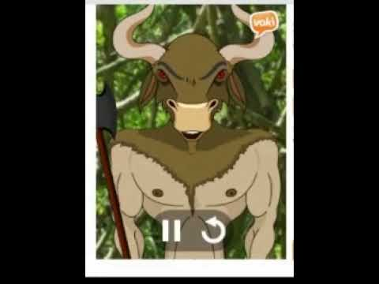
Musings with MUSE
By Dr. Bheemaiah Anil K
Notes:
In Musings With Muse, I the host, Dr Bheemaiah, Anil Kumar, introduce you to the world of Mindfulness, with an EEG based headset, reflect on whether one is needed, the right headset for you and the many activities centered around the headset.

Slide 2
In This Experience I host, I host with Vokis while I teach in both silence and Golden words, mostly in few short words, answering guest’s queries while the Voki’s explain!
A New Experiment in Silence.

Slide 3


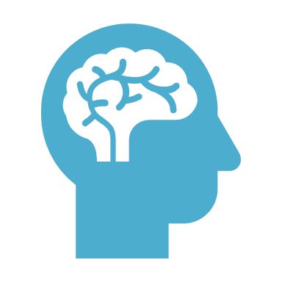
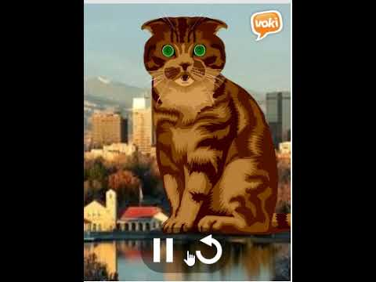

Personal introduction
Host = Dr. Bheemaiah Anil K (Anil Kumar B)
Motive = Mindfulness Evangelism as Wellness
Hardware = MUSE Headset, S or 2
Notes:
I am a professional mental wellness coach, a mountaineering medic and a practitioner of ancient druidadic sciences. Since I am a transhumanist and A.I evangelist, I teach evidence based practices, in integrated medicine, each practice is systematized and repeatable, and objective in evidence, here the evidence is the EEG waveform, used with 5 or more dry electrodes, to create a biofeedback, through soundscapes, to learn meditation. The EEG headset you need to purchase is the MUSE S or MUSE 2.

Slide 4
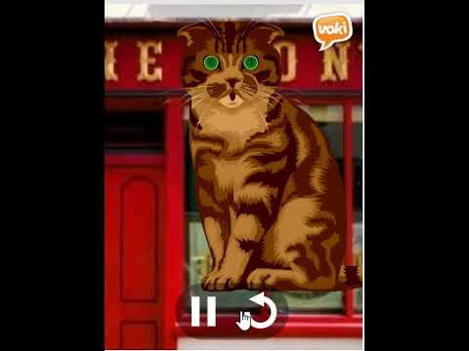
About the Host.
Host is a practicing Neuropsychologist.
Armament = Doctoral Degree in Neuroscience and Applied A.I from UW Madison.
Integrated Medicine Specialization from UMN Twin Cities.
Formal training in T.M at MIU, Fairfield, IA
Notes:
I am a practicing Quantum Healing Specialist and a neuropsychologist by training, I recently added an integrated medicine specialization, to my arsenal, a practice of self healing, as I introduce you to the UMN Bakken Center, and their evangelism for self healing, please attend their free meditation on Mondays. I also have formally trained in Transcendental Meditation at Maharishi University of MAnagement, and teach and practice the very meditation, perfected by Maharishi Mahesh Yogi, a great seer from the Indian Himalayas.

Slide 5
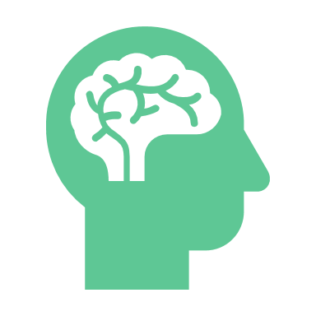

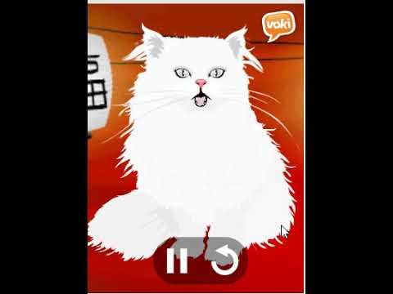


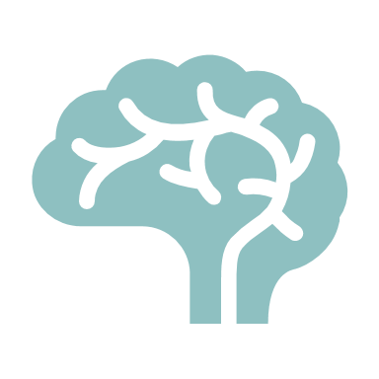
purpose of the experience
Understand, why you need an EEG Headset.
Compare MUSE with Neurosky and other headsets.
Choose between model S and model 2.
Understand how to use the Muse App and the guided meditations.
Understand the numbers, and EEG waves, alpha, beta, gamma, delta and theta.
Notes:
There are several headsets in the market, with MUSE and neurosky, being the most popular, while MUSE uses 7 electrodes in all, neurosky has only three, there are several other headsets, with 32 or 64 electrodes and are the more traditional EEG headsets. While neurosky is cost effective at only $99, we prefer the MUSE headset, though guests are free to try several.
The MUSE S has a headband form factor, as compared to the MUSE 2 headset, there being minor differences, with support for sleep and over 500 different meditations.
Other uses of these headsets are based on BCI or the use of the headset to control smart homes, play computer games and more.
Using the MUSE app is straightforward, after downloading the app from the google play or IOS store, connecting the headset using bluetooth is as straightforward as adding the device with a bluetooth search and wetting the electrodes with water if necessary, till the app indicates, everything is normal.
This is followed by a time based meditation or the use of guided meditations.
In the following images we can understand more about EEG waves.

Slide 6
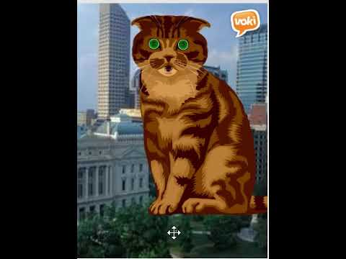
Supplies
Buy
Buy a headset from, https://mbsy.co/pqNPB
Download
Download the MUSE App from Google Play or Apple Store.
Visit
Visit https://www.shapeways.com/shops/coins-unlimited for any mandalas you may need (optional).
Notes:
Supplies, include the MUSE or alternative headset, the MUSE app and a collection of mandalas from the Kalki Chapel store, on the url in the image, the mandalas are merely a concentration aid and are optional.

Slide 7




Prologue.
Introducing Mindfulness with the MUSE.
Notes:
A technical introduction to Mindfulness follows...

Slide 8






Why need a Headset.
Using Biofeedback.
Improving your focus.
Sound as a feedback.
Understanding The Numbers.
Notes:
We reflect on whether we really need a headset, maybe as beginners, biofeedback is essential in an understanding of our minds, a self reflection, knowing ourselves in our monkey minds, the autopilot, the latent parts and the subconscious, the sleep and of course the dream and the transcendental, the meditative bardos. So what are these meditative bardos and can a headset ever reflect it, or is it far above material. Fortunately EEG waves which have a frequency density, can indicate power values in slower waves and slower waves, are an indication that you might be in higher bardo, and your verbal feedback, after the meditation is a sure indicator.
Alpha waves denote the waking state as we move to sleep and dreams and then to REM or delta sleep, or slower waves, beta to delta to theta and gamma, all indicating deep sleep, deep dreams or mindful meditation.
With MUSE, a soundscape and its intensity of sound indicates an error signal on your coherence, in a higher bardo, with transhumanist birds, being a metric of the effectiveness, the whole data from the headset is transhumanist and on the cloud and @edge, meaning on your phone.
This data is processed to numbers, metrics that indicate the coherence of your meditation. A trainer neuropsychiatrist such as myself can help interpret these numbers, the data, and help decide if you are progressing normally.
This is included in the cost of this experience and as you subscribe to more advanced experiences, which follow, you can get feedback on how you are progressing, preferably at the right pace.

Slide 9




MUSE vs Neurosky.
Host recommends MUSE.
Neurosky is a viable alternative.
FreeEEG32 and OpenBCI are experimental, but open source!
Notes:
Neurosky is a popular alternative, and please feel free to Google, buy and explore as many headsets as you can, if there is a public meditation facility, which loans headsets, please feel free to try them too. Stores like Amazon, allow you to purchase many sets and return the ones that are too terrible to own, so that may be a good option too. FreeEEG32 and OpenBCI are research centric, developmental units that cost more or less the same as professional headsets, they may be a good investment if you have a mindset towards the libre philosophies.

Slide 10


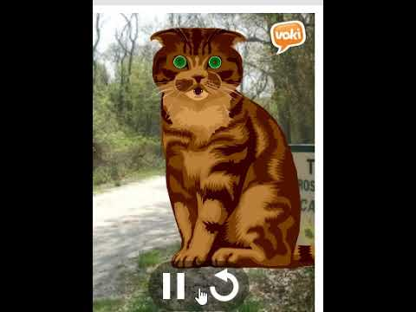

Choosing a meditation.
Start with the basic meditation.
Meditative for as long as is comfortable, maybe 5 minutes or more.
Choose additional meditataions from 200 other meditations, a topic of the next experience.
Notes:
After connecting your headset to the app, start with a basic guided or unguided meditation, for a small duration of time , say five minutes, you could also meditate for just one minute. Define a moment abstractly in your mind, that is one moment of time, if you are the hyper-active kind, a moment may be just five or ten seconds, and you are restless, your monkey mind is at its peak, maybe you would like to develop clarity, patience and other qualities, maybe you want alonger moment, maybe just five minutes of an inner calm silence. Some time with your true inner self, so start slowly and increase the length of your meditation towards that moment. In thesis experience we try a few minutes, but feel free to stop and reflect on your thoughts, the bubbles and the monkey mind, all of which is just as normal.
Later on your own as part of your self exploration, you can subscribe to over 200 other guided meditations on the app and explore them, several advanced experiences, I offer explore several of these guided meditations.

Slide 11
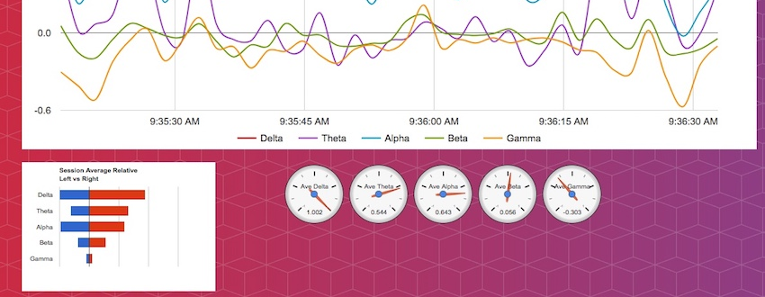
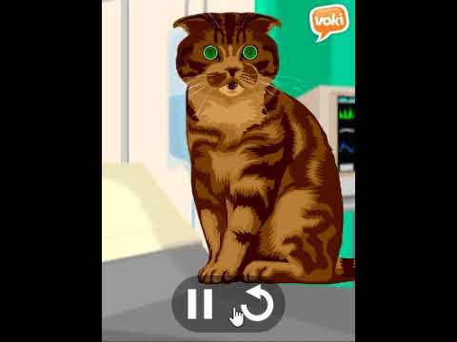
EEG Waves.
◤
Notes:
A minutes reflection on EEG waves, what you see in the figure is the power spectral density, and the power of each kind of wave, the alpha, beta, delta, gamma and theta waves.

Slide 12
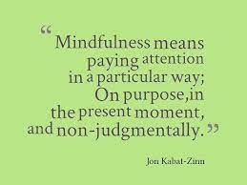
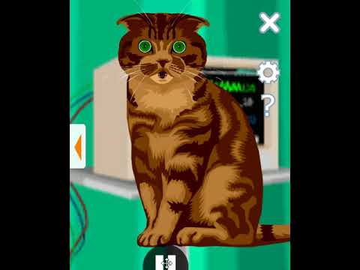
Reflections.
Notes:
Jon Kabat Zinn is a pioneer in Zen meditation, the inventor of mindful minute and the author of several self guided books on mindfulness, here shall we spend a minute or two in reflecting on a definition of mindfulness?
(after one minute)
Is this definition incomplete?
Can you add anything to this?

Slide 13

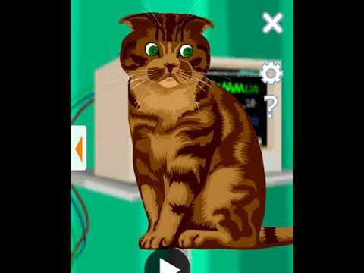

Interpreting Numbers.
Check the coherence, the indices.
Count the birds.
Notes:
Returning to the MUSE meditation, let us understand some of the algorithms MUSE uses, although they are not open sourced, one can take a educated guess at how they compute a metric of coherence in a higher bardo, they use a neural learning algorithms, coupled with older algorithms with formulas of differential and average powers and other metrics of power densities. Differences, across electrodes, help describe, almost mike MRI data, much about active brain areas, all from just seven electrodes.
The indices are plotted as a graph, indicating the coherence, while birds indicate a prolonged coherence, the feedback drives you to a longer and longer coherence as the graph indicates, when you were in a higher bardo and when you came back to an awakened state and again went back in. The data remains for you to reflect on the coherence, the moments and the timeless aspects, the present.

Slide 14
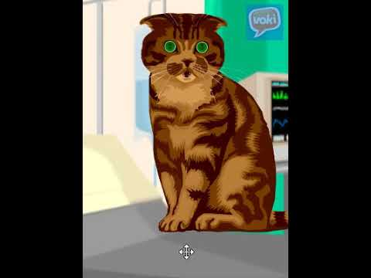
Epilogue.
Join us at https://vayuvaidya.weebly.com
Notes:
In conclusion, as I add social media links you can discover through Vayu Vaidya’s website, the forum really is Muse community site, where you can post blogs, comments etc, and share with the whole MUSE community.

Slide 15
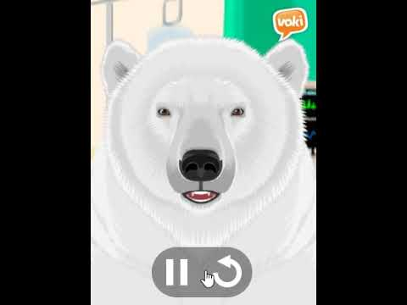
Guest interaction and participation
Feedback after each slide-based talk.
Guest Introductions in the start of experience.
Ends with a discussion on take home messages.
Notes:
To the AirBnB reviewers are the following notes, In the experience presentation, I usually communicate in silence and stop after each slide image to answer any questions, guest introductions are shared on the MUSE forum and at the beginning of the experience, and the experience ends with strong take home messages, a summary of what one learned from the experience.

Slide 16

Demo.
A Five Minute Meditation Session.
Notes:
I end the experience with the real works, a five minute meditation session.

